Slide 1

LOCALHIRE
A PROPOSAL: SCALABLE WEB SERVERS
LOCAL HIRE- DIGITAL MARKETPLACE FOR SKILLED SERVICE PROVIDERS

Slide 2


BRIEF DESCRIPTION OF LOCALHIRE
Digital marketplace for technicians, mechanics, and handymen.
.Built on the MERN stack with MongoDB Atlas and Cloudinary
Simplifies service booking and empowers local professionals

Slide 3

The Problem We Address
The Problem:
The Solution:
Difficulty in finding reliable service providers.
Scalable system with search, booking, and verified providers.
Inefficient existing platforms for large-scale needs.
Modern, cloud-based architecture for seamless performance.

Slide 4
OUR GOALS
Scope:
Objectives:
Impact:
Scalable web server, search, booking, reviews, and Cloudinary
Handle high user demand efficiently.
Simplify finding services.
Ensure fast response times.
Create job opportunities for local professionals.

Slide 5


How We’ll Build it
Tools: MERN stack, AWS, Cloudinary, caching, load balancing.
Phases:
Weeks 1-4: Planning and Design.
Weeks 5-10: Development
Weeks 11-12: Testing.
Weeks 13-14: Deployment.

Slide 6


SUSTAINABILITY AND MONITORING
Sustainability: | Revenue from bookings and commissions. Scalable, cost-efficient cloud architecture
Monitoring: | Tools like Prometheus for performance tracking. Metrics: 99.9% uptime, <500ms response time, user surveys. .

Slide 7
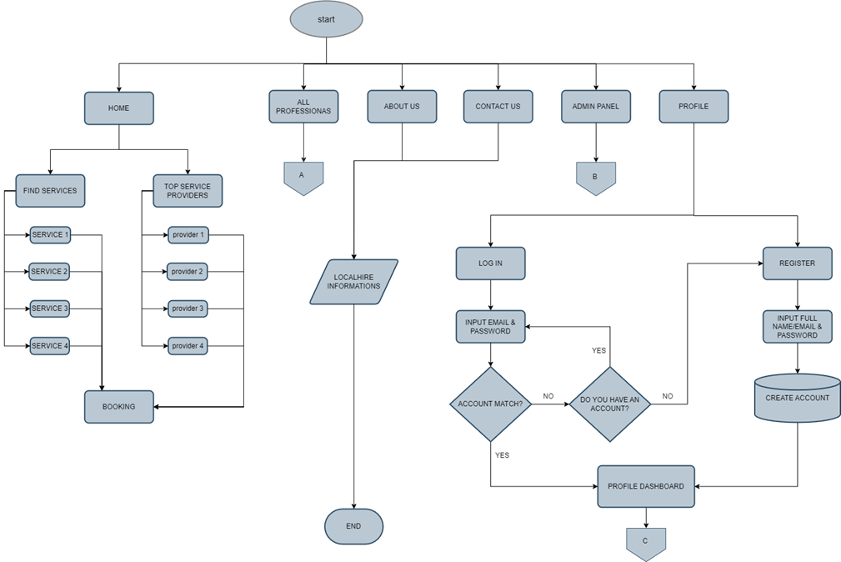
Flowcharts I.

Slide 8
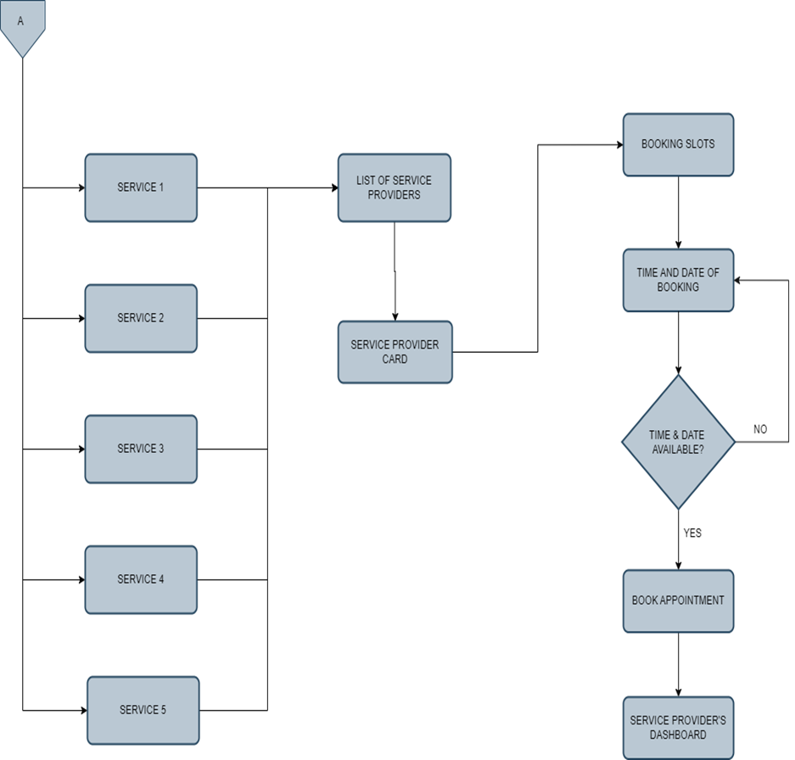
Flowcharts II.

Slide 9
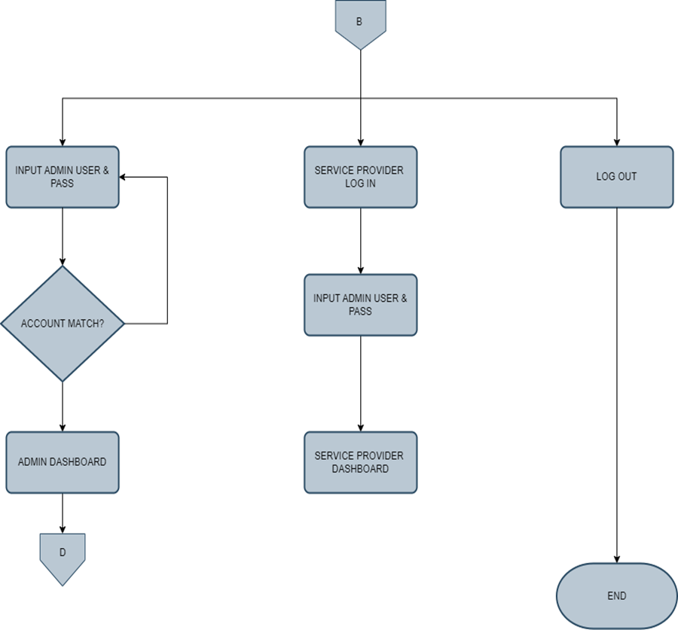
Flowcharts III.

Slide 10
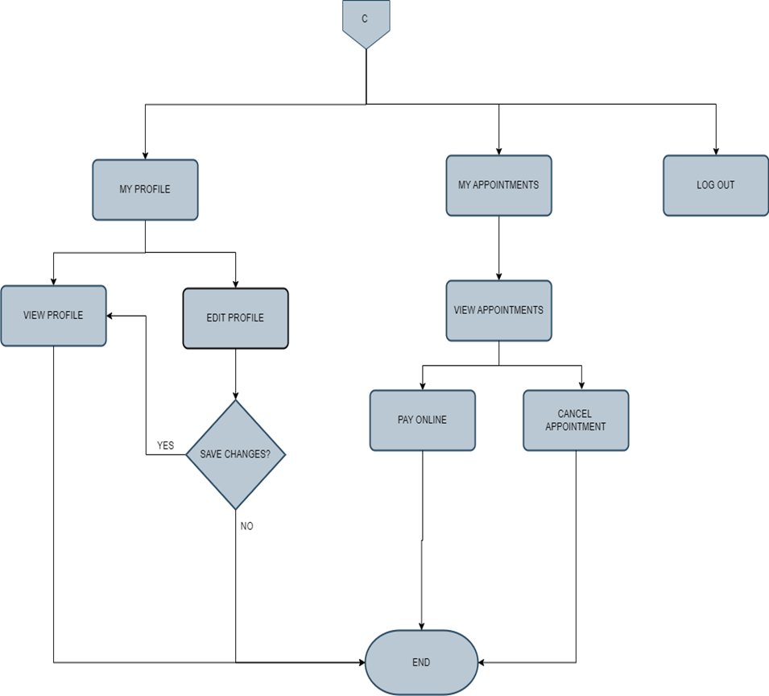
Flowcharts IV.

Slide 11
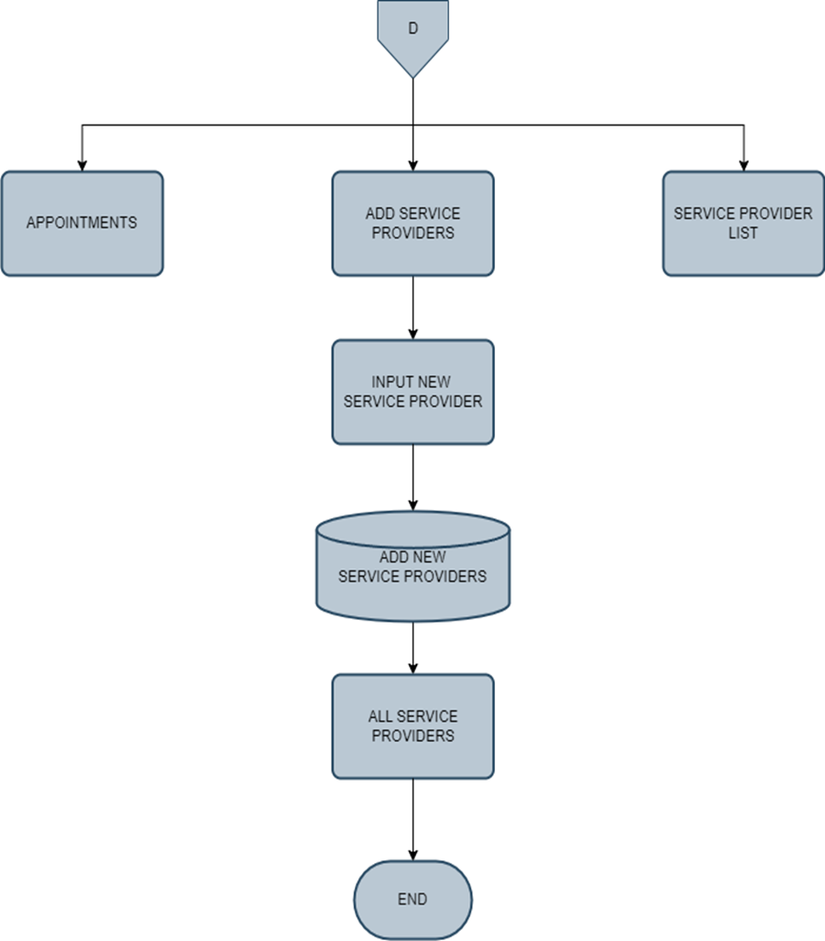
Flowcharts V.

Slide 12


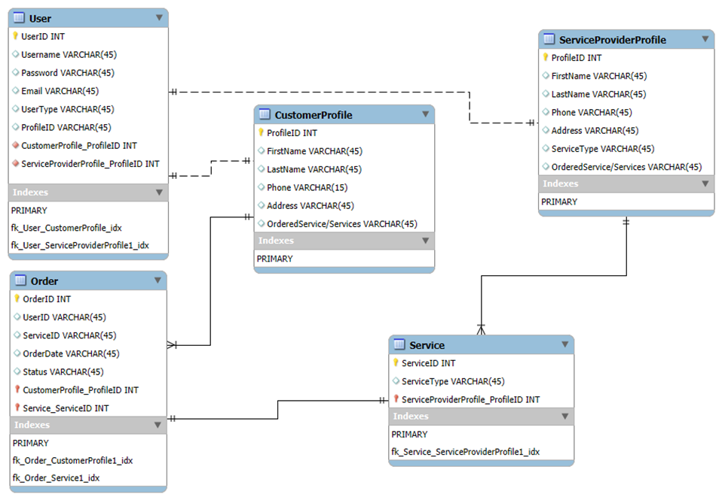
Entity Relationship Diagram

Slide 13



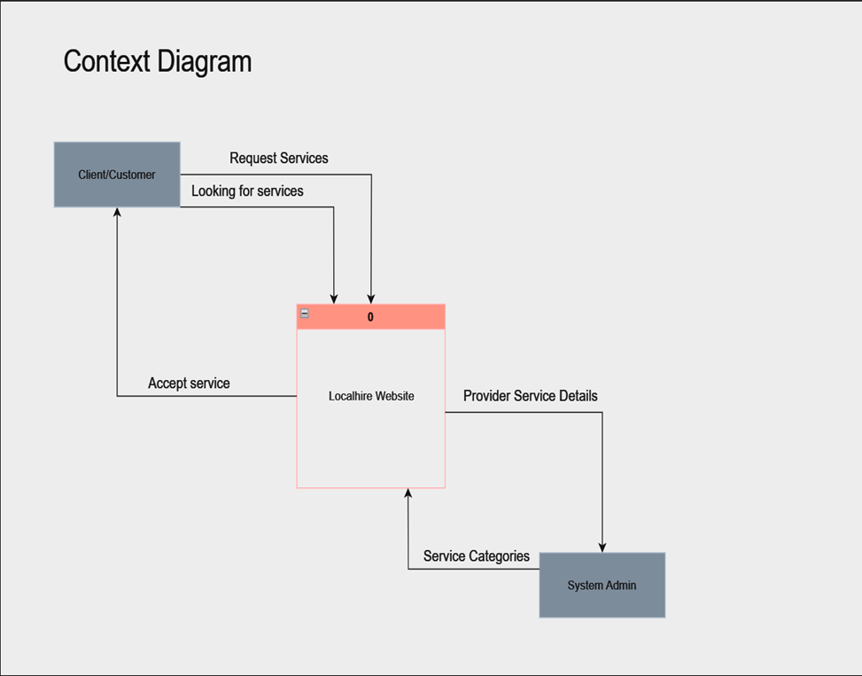
Context Diagram
Level I

Slide 14
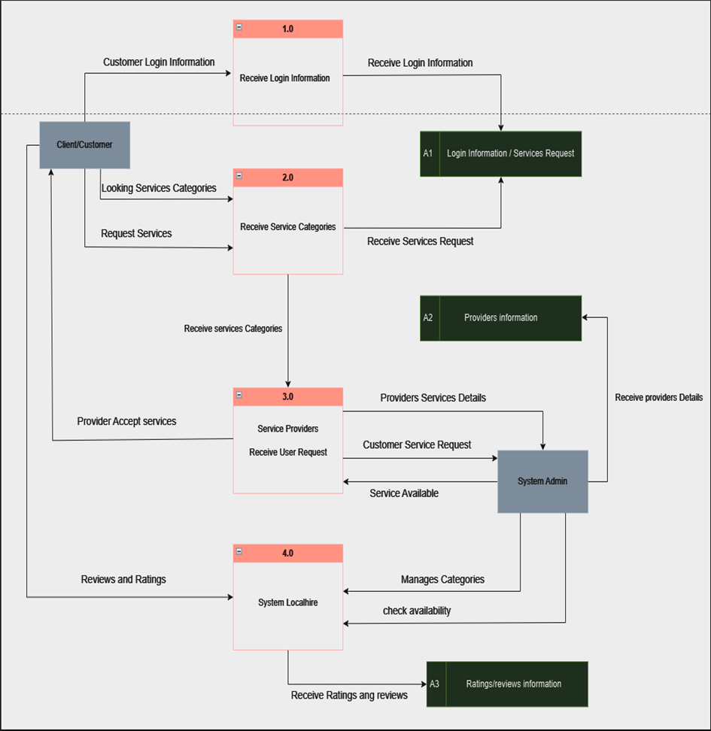
Context Diagram
Level II

Slide 15



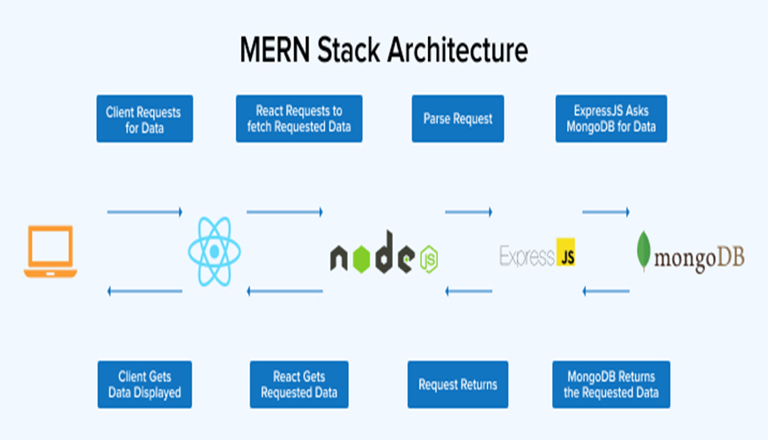


System Architecture

Slide 16


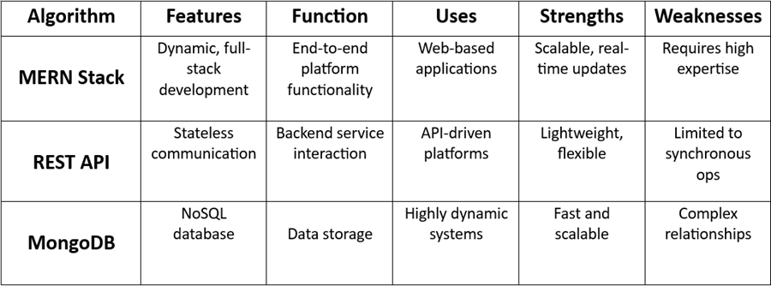
Comparison of the Algorithm

Slide 17

Wireframes (Frontend)

Slide 18
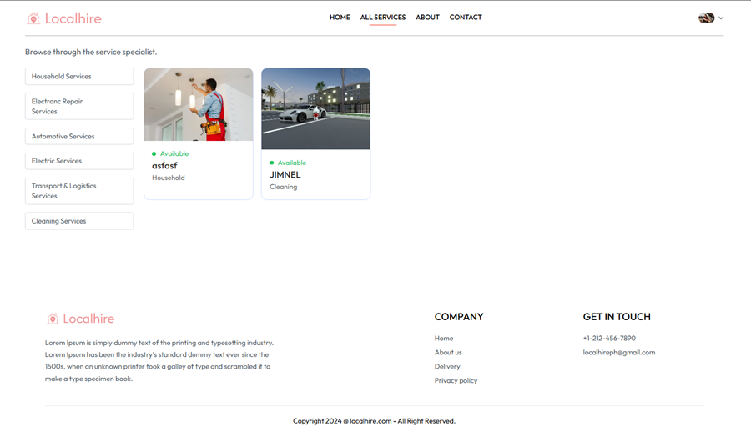
Wireframes

Slide 19
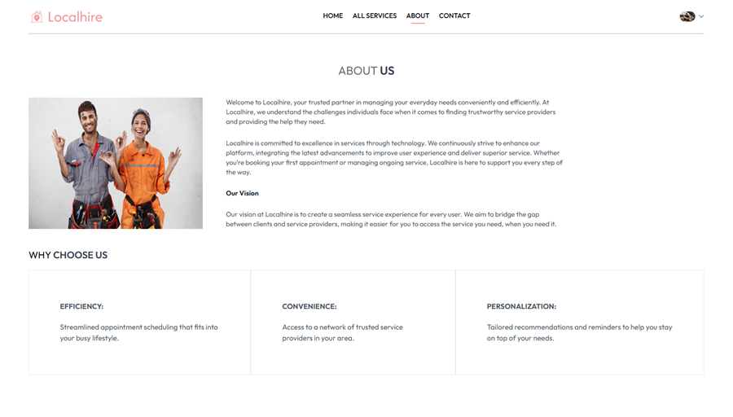
Wireframes

Slide 20
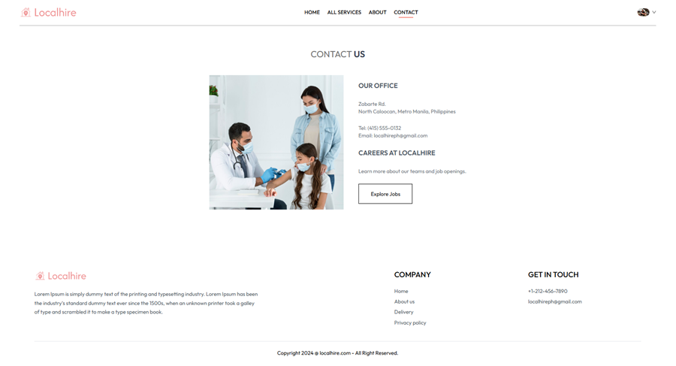
Wireframes

Slide 21

Wireframes (User Profile)

Slide 22
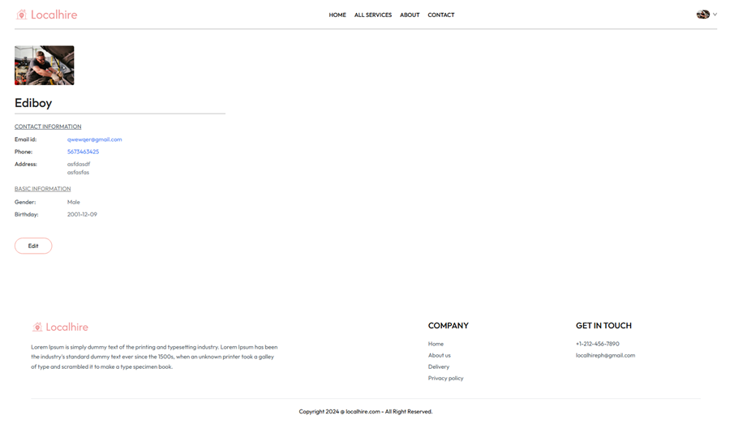
Wireframes (Backend)

Slide 23
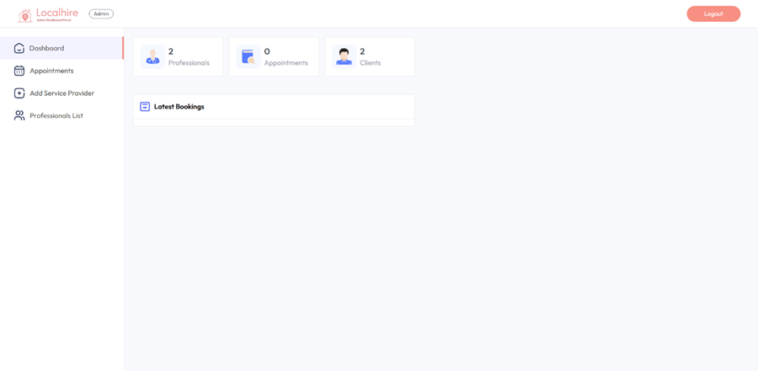
Wireframes (Backend)

Slide 24
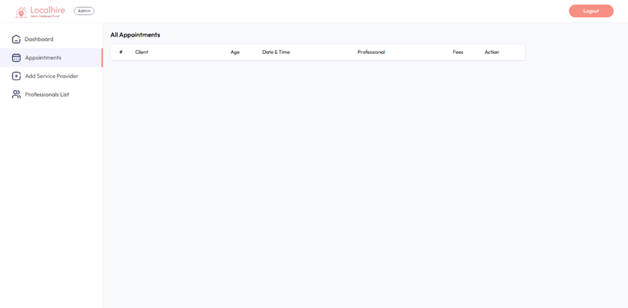
Wireframes (Backend)

Slide 25
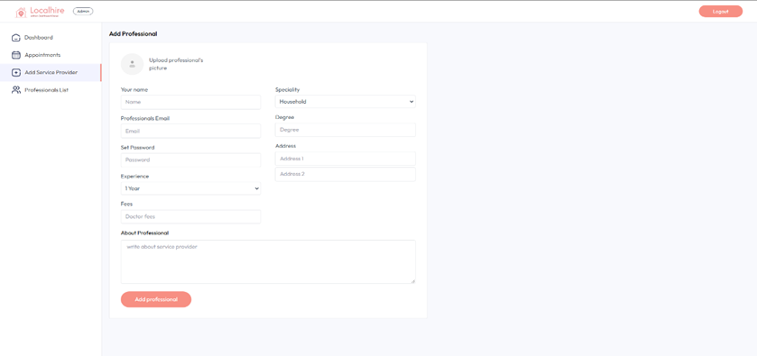
Wireframes (Backend)

Slide 26
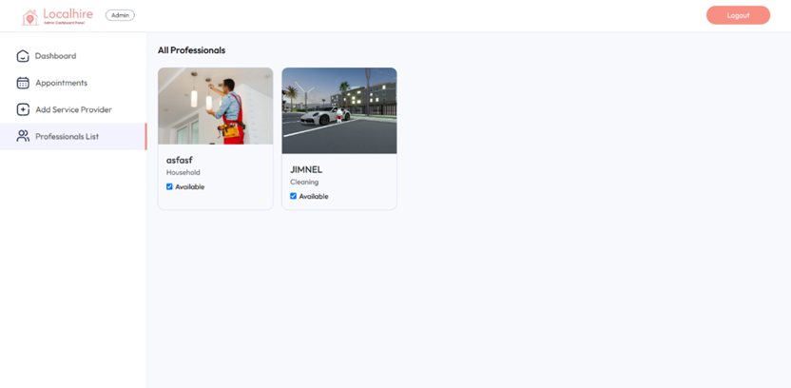
Wireframes (Backend)

Slide 27

Thank you!
For Listening!!!

Slide 28






Bautista, Moana Marie D.
Bustamante, Elijah D.
Calma, Jimnel H.
Daep, Mark JohnericA.
Members:
Hernandez, Newsted James R.
Legaspi, Ed Martin R.
Logronio, Jerald
Santural Jr, Joverth P.

